Slide 1
COVID-19 Impact of Life Insurance Market
Colin Dutkiewicz
Global Head of Life, Reinsurance Solutions, Aon
Lead, IFOA COVID-19 Action Taskforce (ICAT)

Slide 2
IFOA COVID-19 ACTION TASKFORCE
Louise Pryor
Colin Dutkiewicz
Jo Davis

Slide 3
Major Actuarial Practice Boards
Life Insurance
Health&Care
Health Insurance
Risk
Finance & Investments
General Insurance
Resource & Environment
Pensions
Other
Banking, Trusts

Slide 4
Pandemic Dynamics
Pandemic Dynamics
Pharmaceutical Interventions
Non-Pharmaceutical Interventions

Slide 5
Pandemic Dynamics
National
Pandemic Response
Financial Institutions
    Product Provision
    Solvency
    Financial Management
Consumer Outcomes
Economic Environment

Slide 6
ICAT seeks to support practicing actuaries make sense of the current environment and plan for a very uncertain future.
In the process we will inform IFOA members and discover areas of value to act in the public interest.

Slide 7
COVID-19 International Picture

Slide 8
Modelling The Progression Of The COVID-19 Disease
People infected from the novel coronavirus will experience one or more of the stages of the COVID-19 disease
Asymptomatic cases
Symptomatic Cases
Serious
Deaths
Critical
  Some cases will be asymptomatic, which means they are without symptoms. We may never know what proportion are asymptomatic without screening of the population after the outbreak has concluded. Our model does not project the number of asymptomatic cases since the detection rates of asymptomatic cases in many countries may be low, and it is not yet understood if, and to what extent, they can transmit the virus
  The majority of cases which are symptomatic have symptoms that are managed relatively easily, either at home or in a general hospital ward
  A proportion of symptomatic cases will progress to severe illness, requiring more complex hospital treatment, including being categorised as being in serious condition (typically representing admission to intensive care departments)
  A proportion of serious cases will progress to critical condition, requiring more invasive treatment such as ventilation
  A proportion of symptomatic cases will die, likely having passed through the serious and critical conditions if they were hospitalised
1
1
2
2
3
3
4
5
4
5

Slide 9
A well behaved pandemic wave

Slide 10
Western countries less able to contain

Slide 11
Depends heavily on culture and politics

Slide 12
The US least able to coordinate and head warnings

Slide 13
No containment leads to a poor 2nd wave prognosis

Slide 15
COVID-19 Impact of Life Insurance Market

Slide 16
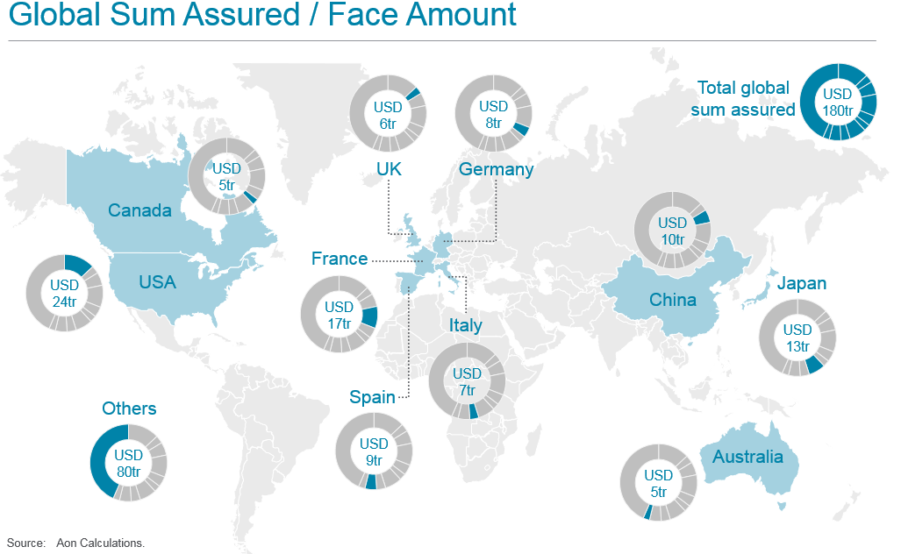

Slide 17
Reinsurance Market View
Munich Re
Even in the very unlikely scenario of a worldwide pandemic equivalent to a 200-year event, Munich Re would face a maximum of 1.4 billion euros in life and health insurance claims – similar in scope to a medium-sized natural catastrophe in property-casualty reinsurance.
Munich Re in its 2019 annual report 18 March 2020

Slide 18
Low-for-Long Interest Rates

Slide 19
Don’t forget what happened in October 2019

Slide 20
Current interest environment isn’t new

Slide 21
Impact on Life Insurance Companies

Slide 22
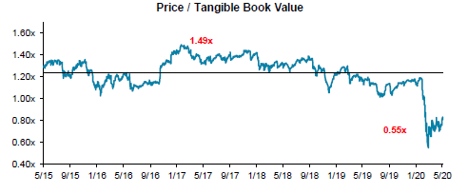
North American Life and Annuity Sector

Slide 23
Western European Life Sector

Slide 24
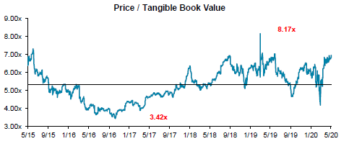
US Health Sector

Slide 25
COVID-19 Impact of Life Insurance Market

